Slide 1
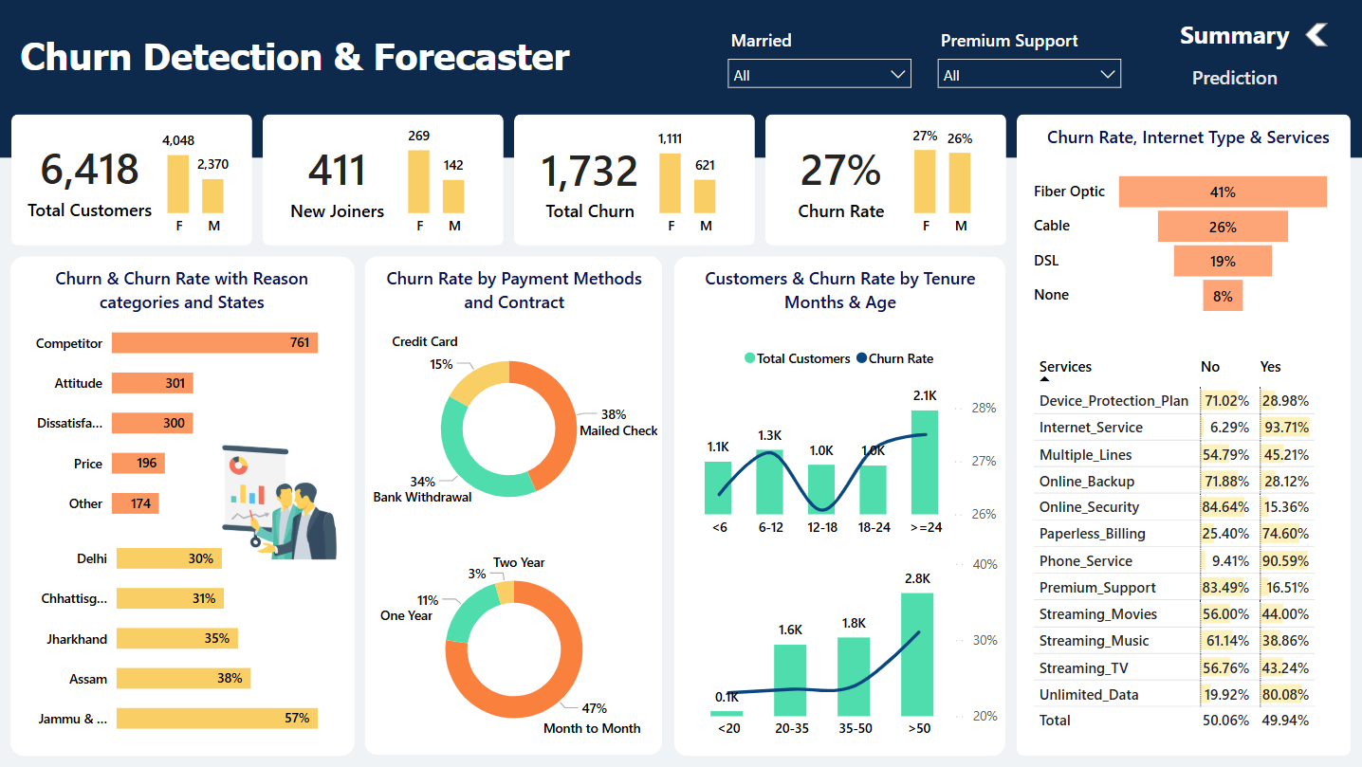

Slide 2
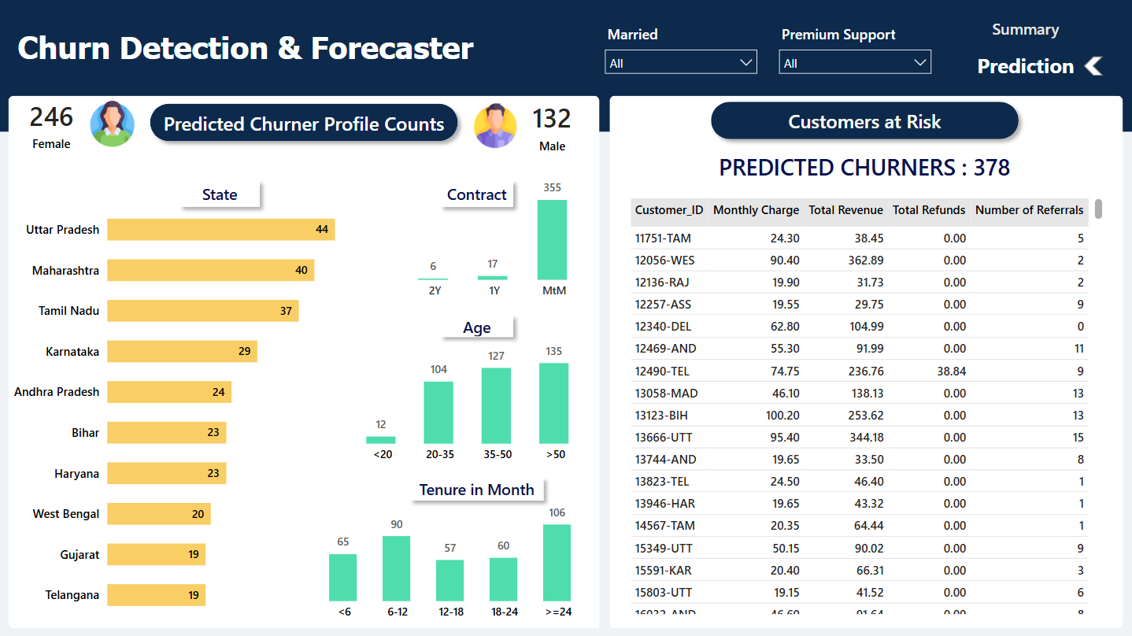

Slide 3

CHURN DETECTION AND
FORECASTER
-BY SAKSHI YADAV

Slide 4




PROJECT OVERVIEW
OBJECTIVE
To help the company proactively reduce customer churn by identifying at-risk customers, understanding key churn drivers, and implementing data-driven retention strategies. This project aims to enhance customer satisfaction, boost revenue retention, and optimize marketing efforts.
METHODOLOGY
Data cleaning and transformation using SQL.
Data visualization and insights generation in
Power BI.
Churn prediction using Python’s Random Forest algorithm.

Slide 5

DATA PREPARATION & CLEANING (SQL)
DATA
EXPLORATION
DATA
CLEANING
DATA
TRANSFORMATION
Checked distinct values to understand data distribution.
Identified and handled null values.
Removed nulls to ensure data accuracy.
Inserted cleaned data into the production table.
Created a SQL View to streamline Power BI integration.

Slide 6


CHURN ANALYSIS DASHBOARD
– UNDERSTANDING CUSTOMER BEHAVIOR
DATA USED
Integrated transformed data from SQL Server into Power BI.
TRANSFORMATIONS APPLIED
Standardized data and removed inconsistencies.
Created calculated measures for churn rate and tenure analysis.
Applied DAX formulas for KPI calculations.
Integrated slicers and filters for dynamic analysis.

Slide 7
CHURN ANALYSIS DASHBOARD
– UNDERSTANDING CUSTOMER BEHAVIOR
KEY INSIGHTS
Demographic Impact on Churn: Younger customers and those with short tenure are more likely to churn.
Contract Type Influence: Customers on monthly contracts have a significantly higher churn rate than those on long-term plans.
Payment Method & Billing Effects: Customers using electronic check payments show higher churn, indicating possible dissatisfaction with payment processes.
Service-Related Churn: Poor customer support and unreliable internet service contribute heavily to churn.

Slide 8



CHURN PREDICTION USING PYTHON
WHY PYTHON?
Advanced predictive analytics capabilities.
Seamless integration with Power BI.
WHY RANDOM FOREST?
Handles large datasets efficiently.
Reduces overfitting by using multiple decision trees.
Provides feature importance scores for better insights.

Slide 9
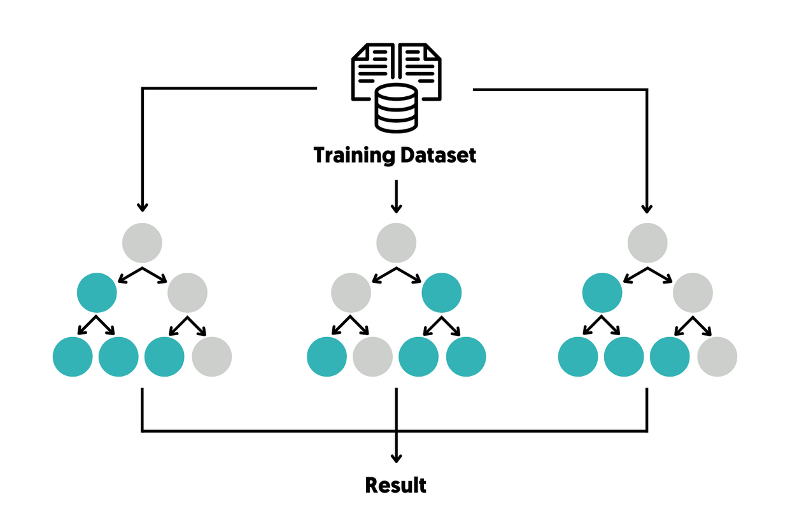
CHURN PREDICTION USING PYTHON
UNDERSTANDING
RANDOM FOREST ALGORITHM
An ensemble learning method using multiple decision trees.
Votes on the most probable outcome (churn or no churn).
Uses Gini Impurity and Feature Importance for decision-making.

Slide 10
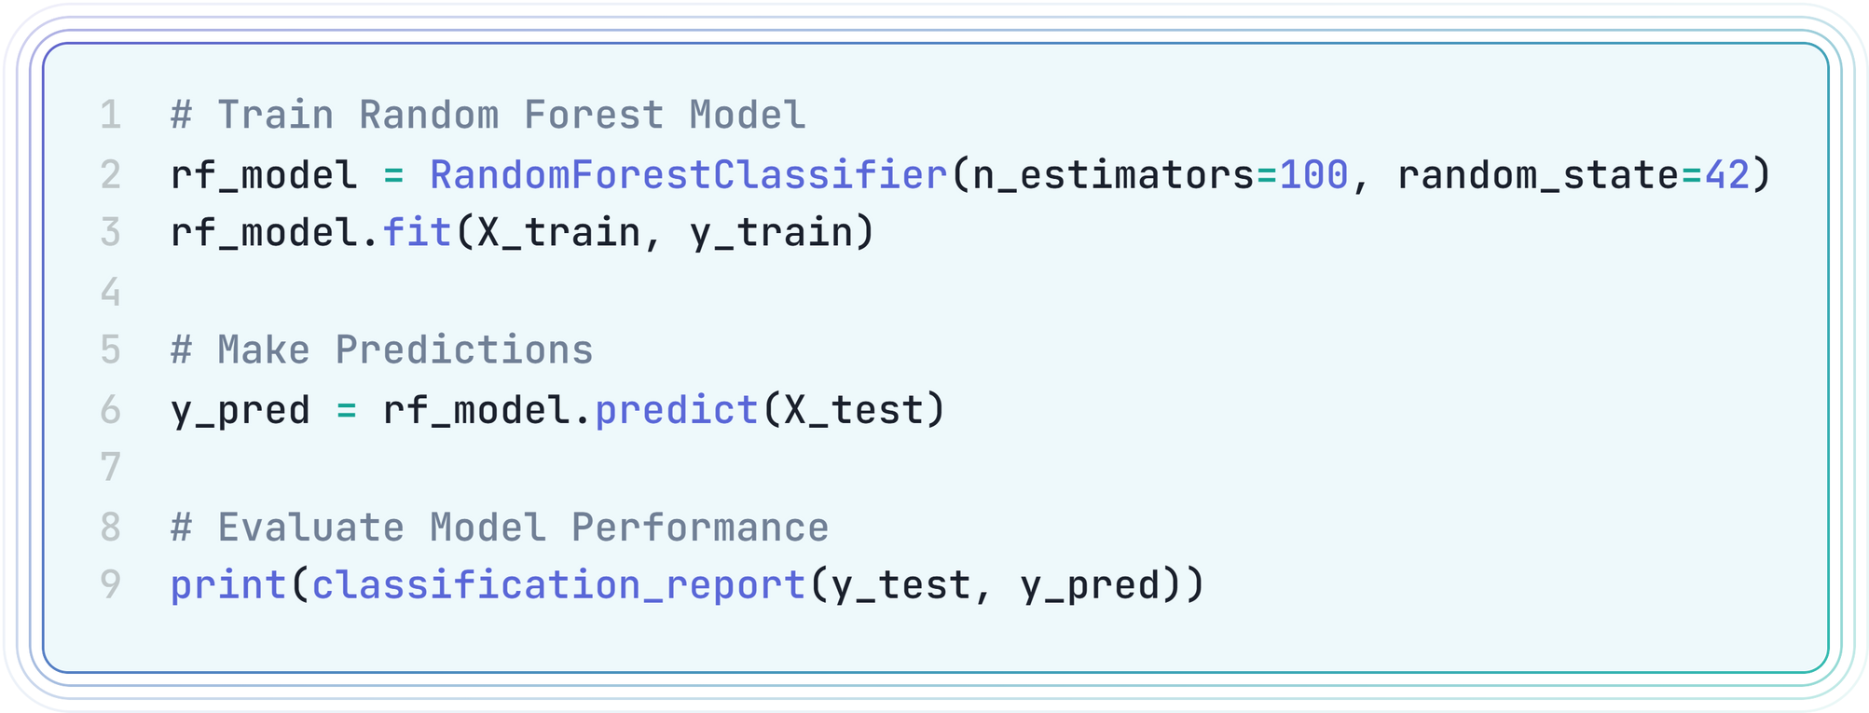
CHURN PREDICTION USING PYTHON
ESSENTIAL PARTS OF MODEL TRAINING AND PREDICTION.

Slide 11
CHURN PREDICTION DASHBOARD
– FORECASTING FUTURE RISKS
DATA USED
Integrated Python-generated predictions into Power BI.
TRANSFORMATIONS APPLIED
Created new KPIs to track predicted vs. actual churn.
Developed comparison visuals to assess model accuracy.
Applied advanced filtering to identify high-risk segments.

Slide 12
CHURN PREDICTION DASHBOARD
– FORECASTING FUTURE RISKS
KEY INSIGHTS
Prediction Accuracy: The model correctly flagged high-risk churners, matching historical churn trends.
Customer Profiles at Risk: Predicted churners tend to have low tenure, high monthly bills, and limited service engagement.
Actionable Interventions: Offering retention strategies (discounts, personalized offers) to predicted churners can reduce churn rates significantly.

Slide 13


RESULTS & BUSINESS IMPACT
Key Findings
SQL cleaning and analysis improved data quality by 22%.
Power BI dashboards provided actionable insights on churn drivers.
Python model achieved 84% accuracy in predicting churners.

Slide 14

BUSINESS RECOMMENDATIONS
Offer discounts or loyalty programs for high-risk customers.
Improve customer service interactions to reduce churn.
Focus on long-term contracts to increase retention.

Slide 15
CONCLUSION
What worked well: Integration of SQL, Power BI, and Python for a full churn analysis pipeline.
Future improvements: Testing additional ML models (e.g., XGBoost, Logistic Regression).
Possible Enhancements: Adding real-time churn tracking using automated pipelines.

Slide 16


THANK YOU

